Slide 1
C++ Project Basics
Visual Studio
Creating a new project
Adding files to the project
Building & Running the project
Debugging with Breakpoints
Debugging with Stack Trace
Kludgey debugging with cout

Slide 2
1. Getting Visual Studio
As a student, you can get a free copy of Visual Studio. See the document on how to on the class webpage, under CS201L Lab documents, open the “Using Microsoft DreamSpark to Download Visual Studio.docx” file.
Class webpage:
https://github.com/Moosader/Problem-Solving-and-Programming-II

Slide 3
1. Getting Visual Studio
You can also download Visual C++ Express for free at any time from Microsoft.

Slide 4
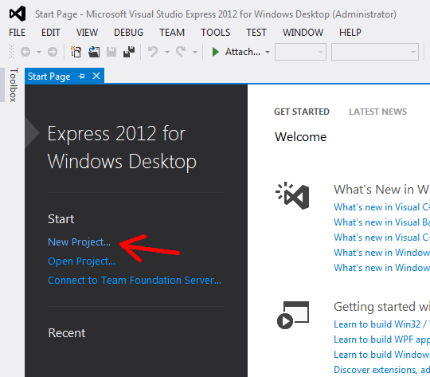
2. Creating a new Project
Open up Visual Studio and click New Project...
I am using Visual Studio Express 2012 here.

Slide 5
2. Creating a new Project
Under Visual C++ templates, select Empty Project.
Update the Location field -
THIS SHOULD BE INSIDE OF YOUR PROJECT REPOSITORY FOLDER!

Slide 6
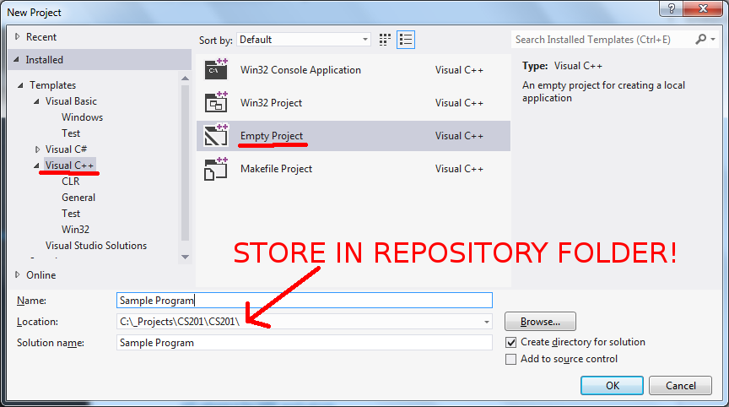
2. Creating a new Project

Slide 7
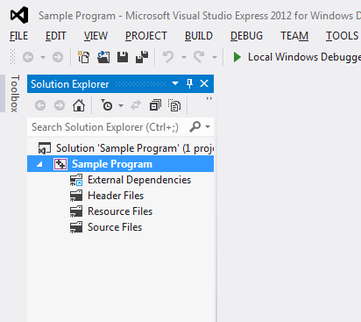
2. Creating a new Project
Your project will be created without any files.
Notice the Solution Explorer, this is where your files will be displayed.

Slide 8
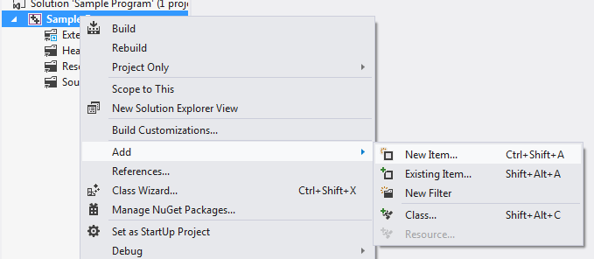
3. Adding Files
To add a source file to the project, right-click the project, go to Add and select New Item...
The keyboard shortcut is CTRL+SHIFT+A

Slide 9
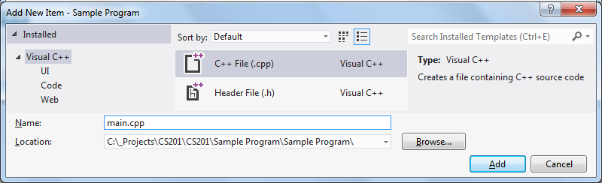
3. Adding Files
Under Visual C++ on the left, select
C++ File (.cpp).
If we were creating a new class, you would use Header File (.h) as well.

Slide 10
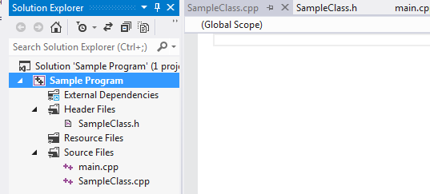
3. Adding Files
These files will be categorized based on their file type (source or header), though in Windows Explorer they will be in the same folder.

Slide 11
4. Creating a small program
Open main.cpp and enter some code:

Slide 12
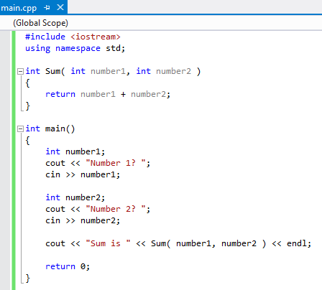
4. Creating a small program

Slide 13
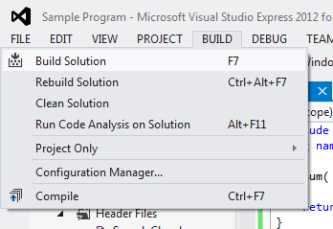
5. Building & running your program
Build the program by going to BUILD and select Build Solution
The keyboard shortcut is F7 in VS 2012

Slide 14
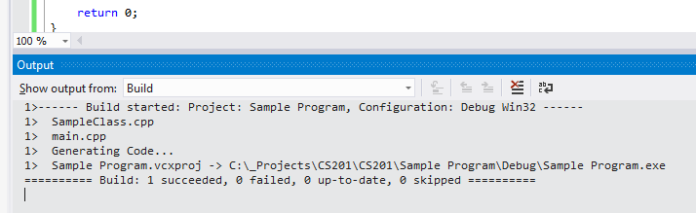
5. Building & running your program
If there are no errors, the Output window at the bottom of the screen should say 1 succeeded

Slide 15
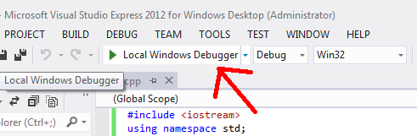
5. Building & running your program
You can use the play button to run the program.
The program will quit automatically when it hits return 0;

Slide 16
6. Debugging with Breakpoints
At some point, you might have a non-obvious bug in your program you need to debug.
Visual Studio (and other IDEs) have debugging tools available to make it easier.

Slide 17
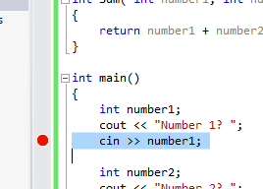
6. Debugging with Breakpoints
You can activate a breakpoint by double-clicking in the margin next to your code.

Slide 18
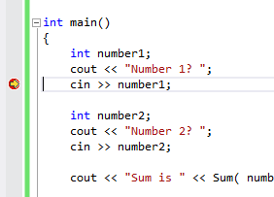
6. Debugging with Breakpoints
When you run your program, it will start up as normal, but once it hits a breakpoint it will pause the program execution and bring you to the IDE.

Slide 19
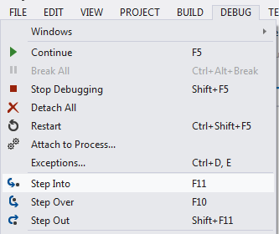
6. Debugging with Breakpoints
You can continue stepping through the program execution line-by-line using the DEBUG menu.
Step Into will take you into a function if called, or a block of code.
Step Over will go over the line of code to the next line.
Step Out will take you outside of a function or block.

Slide 20
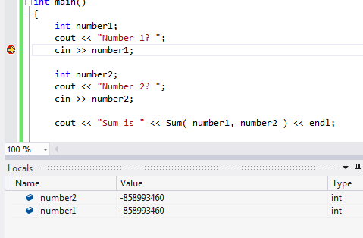
6. Debugging with Breakpoints
The Locals window will show you variables that are local to the current function.

Slide 21
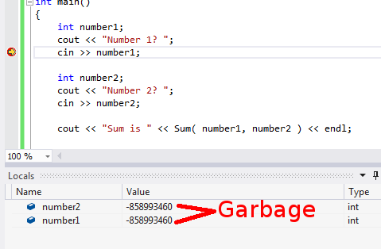
6. Debugging with Breakpoints
At this point in the program, number1 has been declared but the cin >> number1; command has not executed.
Both variables have “garbage” for their values.

Slide 22
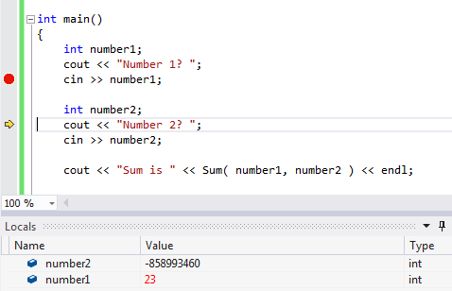
6. Debugging with Breakpoints
If we use “Step Over” (then go back to the program and enter a number), the Locals window will be updated with the new value.

Slide 23
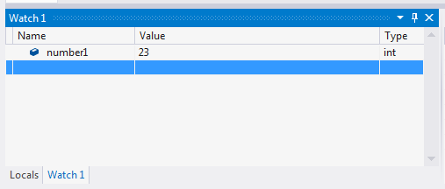
6. Debugging with Breakpoints
In the same pane as the Locals window is the Watch tab. Here, you can type in a variable's name and keep track of its value as the program runs.

Slide 24
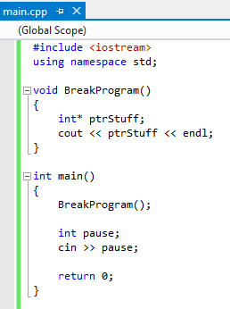
7. Debugging with the Stack Frame
Here is the new program. It will crash.

Slide 25
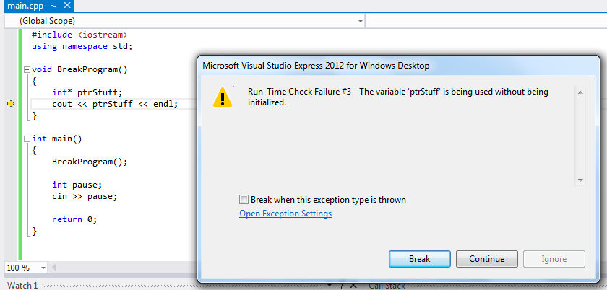
7. Debugging with the Stack Frame
If we run the program, it will begin, crash, and then bring us to the IDE.

Slide 26
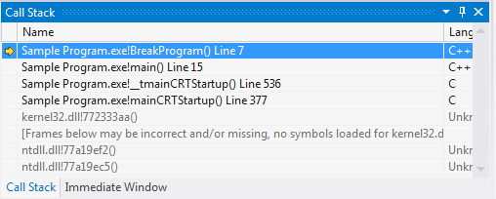
7. Debugging with the Stack Frame
If you click Break, you can view the Call Stack in Visual Studio. This shows a list of functions called in the program thus far.

Slide 27
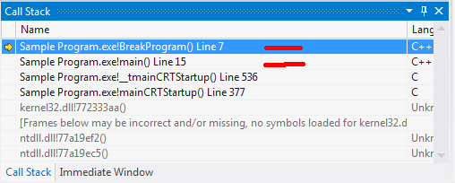
7. Debugging with the Stack Frame
We can see that BreakProgram() was the most recent function called
Under that, we were in main()

Slide 28
7. Debugging with the Stack Frame
The Stack Trace is a handy way to figure out the path the program had taken prior to crashing, or prior to your breakpoint pausing the program.

Slide 29
8. Debugging with cout
If you want to be lazy, you can try to pinpoint where your program broke just by outputting information to the console at certain points to follow the program flow.

Slide 30
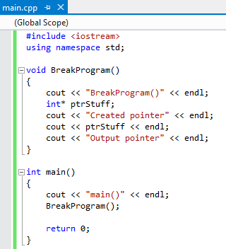
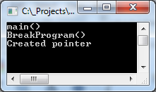
8. Debugging with cout
We can tell that the “Output pointer” text was never printed to the screen, so the crash happened between
“Created pointer” and “Output pointer”.

